Slide 1

Customer success
Monthly support report
Lazar Milicevic
Key metrics, achievements, roadmap & next steps
July 2025

Slide 2
Agenda
1
Part I: Abstra support key metrics
2
Part II: Achievements & roadmap
3
Part III: Roadmap items
deep dive
4
Part IV: Product Insights
5
Part V: Next steps

Slide 3
Executive Summary
Customer success: Monthly Support Report - July 2025
Metrics summary:
62 tickets handled in July (–25.30% vs June), reflecting stable post-launch operations and efficient ticket triage.
First response time averaged 31 minutes, maintaining SLA compliance across all K-Navigator flows with dynamic SLA alerts.
Average resolution time increased to 1.3 hrs (+18%), driven by a few extended cases but remained within SLA.
CSAT at 94.4%, confirming sustained service quality and positive user sentiment.
Blocking issues remained minimal (4 total), all resolved within SLA boundaries.
Zendesk & Process Improvements
Enhanced Python K Signup Reporting Tool with batch processing, auto-cleanup, and error resilience for long-range reporting.
Extended 3-strike auto-closure monitoring, optimizing backlog management.
Developed PostHog dashboards to centralize SLA metrics, UX friction insights, and automate FRT breach detection.
TL;DR - Most important points in one place!
Owkin K
371 K-Navigator tickets processed, maintaining high triage accuracy with structured ownership.
Signup flows stabilized, enabling focus on scalable documentation and automation efforts.
Fully operational Python reporting pipeline now supports daily Zendesk reporting with new metrics.
K – Navigator PostHog dashboards created for behavioral monitoring, SLA tracking, and onboarding quality improvements.
Laid groundwork for Q4 automation upgrades and streamlined SLA breach alerts across squads.

Slide 4

Agenda
1
Part I: Abstra support key metrics
2
Part II: Achievements & roadmap
3
Part III: Roadmap items
deep dive
4
Part IV: Product Insights
5
Part V: Next steps

Slide 5
Abstra at a glance - Fullstory Metrics
Customer success: Monthly Support Report - July 2025
A general overview of numerical metrics and feature adoption compared with previous month
General Metrics
Catalog Metrics
Slide Viewer Metrics
Other Metrics
Active Users
136
-4.2%
Dataset Search
923
-15.4%
Users
57
+3.6%
Target Directory Users
5
-16.7%
New Users
41
0.0%
Dataset Views
3416
+1%
Sessions
301
-34%
Average session
per user
25
-23.9%
Abstra
Documentation
27
-20.6%

Slide 6
Key metrics overview
Customer success: Monthly Support Report - July 2025
June
July
Change
General monthly key metrics
Tickets Received
83
62
-25.30%
July reflected a slight decline in efficiency and response times compared to June, primarily due to handling more complex access-related requests and a lower volume of quick-resolution tickets. Despite this, all metrics remained well within SLA thresholds, confirming the robustness of our support workflows.
📥 62 tickets received – a -25.30% decrease from June, demonstrating stable system behavior and effective filtering via improved Zendesk forms.
⚙️ Solved rate of 74.19% – a -16.66% drop, largely due to pending tickets that required extended coordination or remained in progress at month-end.
⏱️ 31 min average first response time – a +72.22% increase, yet significantly below our SLA target of 2 hours, ensuring prompt agents engagement despite the shift in ticket complexity.
🛠️ 1.3 hrs full resolution time – an +18.18% increase, still comfortably within the 24-hour SLA window, indicating that even extended cases were handled efficiently.
🌟 94.4% CSAT – a -5.60% decrease, but remains a strong indicator of positive user sentiment and satisfaction with support interactions.
🔍 Please note:
The reported metrics exclude API-generated tickets from integrations and external systems. We continue tracking only Abstra-relevant forms, ensuring consistency with historical reporting standards. Total ticket volume in July exceeded 400 when including API-sourced tickets, mostly related to the K-Signup requests.
Solved/Received
89.02%
74.19%
-16.66%
Average First Response Time (Bus. hrs.)
18 min
31 min
+72.22%
Average Full Resolution Time (Bus. hrs.)
1.1 hrs
1.3 hrs
+18.18%
% Satisfied CSAT
100%
94.4%
-5.60%
Key Observations:
✔️ Ticket volume remains stable and predictable, supported by structured Zendesk forms and refined pre-filtering mechanisms, ensuring workload consistency despite fluctuations in request types.
✔️ Metrics exclude API-submitted tickets originating from external integrations and systems, mostly related to the K-Signup requests, focusing exclusively on Abstra-relevant forms in line with historical reporting methodology.
✔️ The total ticket volume exceeded 400 in July when including API-generated tickets, maintaining a consistent workload across all support channels.
✔️ Internal workflows are continuously optimized, with a focus on balancing complex access requests with efficiency in response and resolution times — all key metrics remained well within SLA thresholds (2h First Response, 24h Full Resolution).
*Times are in business hours.

Slide 7
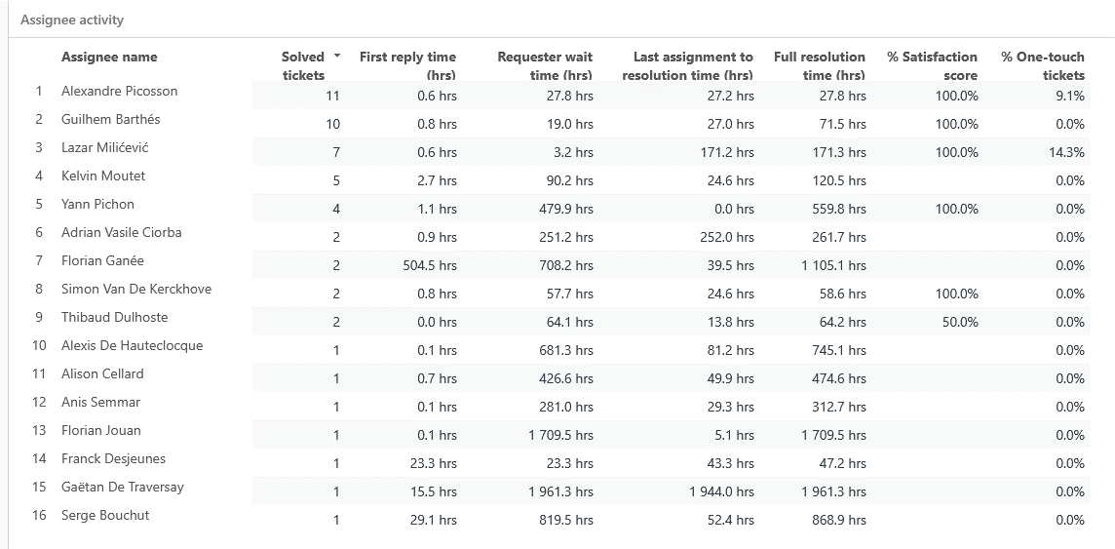
Monthly Ticket Counts & Average Resolution Times
Customer success: Monthly Support Report - July 2025
Compared with previous 3 months
2025
Tickets Received
Avg. Full Resolution Time
April
174
11 hrs
May
113
2.2 hrs
June
83
1.1 hrs
July
62
1.3 hrs
*Times are in business hours.
July Summary
✔️ 62 tickets – down 25.30%, reflecting stable system operations and effective pre-filtering.
✔️ 31 min FRT – increased by 72.22%, but still significantly below SLA (2h limit).
✔️ 1.3 hrs resolution – slight increase of +18.18%, maintaining a strong position under the 24h SLA threshold.
✔️ 94.4% CSAT – minor decrease (–5.6%), yet still indicating strong user satisfaction.
Note: Metrics exclude API-based tickets. Total ticket volume exceeded 400 across all channels.
We remain focused on balancing complex request handling with responsiveness as internal demands evolve.

Slide 8
Blocking issues key metrics overview
Customer success: Monthly Support Report - July 2025
Monthly metrics and changes for the reported blocking issues
Blocking issue volume decreased in July, with 4 reported cases, a -55.56% drop from June, reflecting a lower incidence of urgent system blockers.
While overall volume decreased, resolution performance presented mixed results.
First response times improved significantly, but full resolution times increased due to a small number of complex tickets requiring extended coordination.
All metrics remained within SLA thresholds.
✅ First response time averaged 12 minutes (0.2 hrs) — a 60% improvement compared to June, ensuring prompt initial engagement for critical requests.
🕒 Average resolution time reached 18.4 hrs — an increase of +159%, driven by a few complex cases that extended beyond typical resolution cycles.
Despite this, resolution remained well within the 24-hour SLA window.
We're continuing efforts to identify and mitigate blocking issues earlier in the lifecycle. Learnings from July are being applied to further refine prioritization and routing processes for complex case handling.
June
July
Change
Tickets Received
9
4
-55.56%
Solved
9
4
-55.56%
Average First Response Time (Bus. hrs.)
0.5 hrs
0.2 hrs
-60.00%
Average Full Resolution Time (Bus. hrs.)
7.1 hrs
18.4 hrs
+159.15%
*Times are in business hours.

Slide 9
Number of tickets received per topic
Customer success: Monthly Support Report - July 2025
Increasing tickets related to Dataset Creation as well as SageMaker issues.
July maintained a steady influx of recurring technical topics, with SageMaker issues and project onboarding requests continuing as dominant themes. Additionally, there was a notable increase in dataset creation requests, reflecting evolving support needs.
📌 The most notable trends this month include:
✅ 8 tickets related to SageMaker - consistent usage patterns, focusing on troubleshooting and environment setup.
✅ 6 tickets requesting the creation of new Abstra Projects - highlighting ongoing onboarding activities and team expansion.
✅ 2 tickets requesting to be added to user groups - supporting access and permissions management processes.
✅ 3 tickets under Other - covering internal tool support, minor troubleshooting, and process-related requests.
✅ 2 tickets for enabling CI access to CodeArtifact registry - stable request volume for developer workflow optimization.
Topic
Tickets
Other
3
SageMaker Issues
8
Create a new Abstra Project
6
Request to be added to user group
2
Allowing CI to access codeartifact package registry
2
Notes:
rank by desc order

Slide 10
Trend in topics received compared with previous month
Customer success: Monthly Support Report - July 2025
Highest changes in number of tickets received per topic
June
June
Change
July ticket trends revealed a mixed dynamic across key technical topics, with a notable increase in general support requests and onboarding activities. Dataset creation requests saw a drop, while SageMaker-related issues remained stable.
● "Other" category increased by +50.00%, reflecting a rise in internal tool and ad-hoc support requests.
● SageMaker Issues remained stable (0.00%), maintaining a consistent demand for environment setup and troubleshooting support.
● Requests for new Abstra Projects rose by +50.00%, indicating renewed onboarding activities after a quieter June.
● Dataset Creation Approval requests decreased by -50.00%, suggesting a temporary slowdown in new data onboarding flows.
● CodeArtifact CI access requests declined by -33.33%, reflecting reduced activity in developer pipeline integrations for this cycle.
Other
2
3
+50.00%
SageMaker Issues
8
8
0.00%
Create a new Abstra Project
4
6
+50.00%
Dataset::Dataset Creation Approval Request
4
2
-50.00%
Allowing CI to access codeartifact package registry
3
2
-33.33%

Slide 11
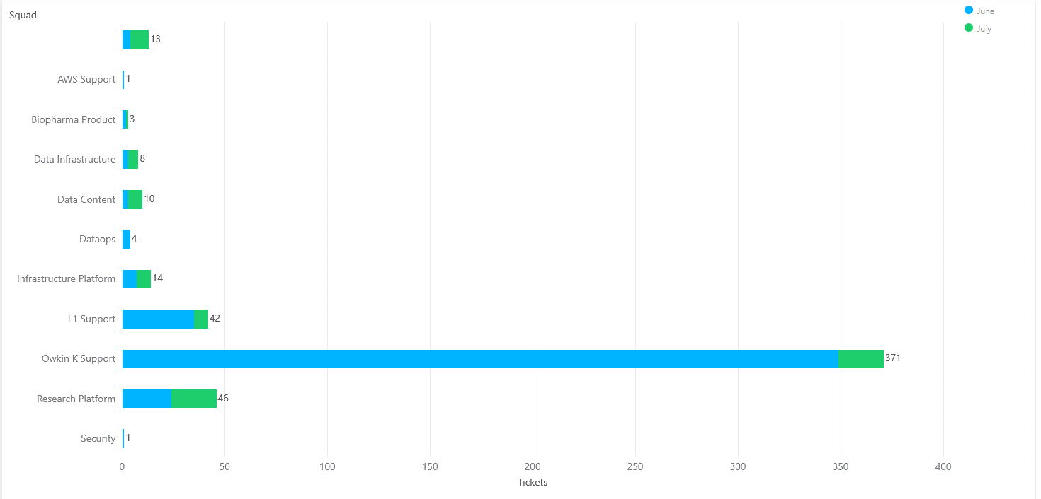
Tickets per squad
Customer success: Monthly Support Report - July 2025
Month-over-Month (MoM) Overview for ticket counts per squad
Owkin K Support processed 371 tickets in July, up from 355 in June, reflecting a 4.5% increase. The squad remains the most active, managing the majority of daily operational and signup-related requests.
The Research Platform squad handled 46 tickets, maintaining a high involvement in experimentation workflows and advanced tooling support, with a slight drop compared to June.
L1 Support processed 42 tickets, continuing to play a pivotal role in triaging and onboarding new users, ensuring consistent first-line support coverage.
Infrastructure Platform handled 14 tickets, supporting internal configurations and AWS access tasks — a slight increase from previous cycles.
Data Infrastructure, Data Content, Biopharma Product, and DatOps squads handled between 3–10 tickets each, covering specialized needs in data onboarding, pipeline configurations, and platform access support.
Security and Solution Architecture each managed 1 ticket, indicating low-volume but essential specialized support requests.

Slide 12
Help Center article views - July 2025
Customer success: Monthly Support Report - July 2025
Most viewed help center articles in the month
Top articles viewed this month:
Owkin K - Brand
Abstra - Brand
Article
Views
Article
Views
Owkin K User Guide: Getting started
145
"HOME PARTITION FULL" warning message
3
Owkin K User Guide: Available plots
23
My workspace is not starting
2
Owkin K User Guide – Available data
19
Dataset creation approval request
2
What are the previous versions of Owkin K Navigator Terms & Conditions?
19
How to access Owkin's Github
2

Slide 13


🏆
Superstar of the month!
Part title
Alexandre Picosson
Handling most number of L2 tickets
Thibaud Dulhoste
For having the least first response time of 0.01
business hours

Slide 14

Agenda
1
Part I: Abstra support key metrics
2
Part II: Achievements & roadmap
3
Part III: Roadmap items
deep dive
4
Part IV: Product Insights
5
Part V: Next steps

Slide 15
Customer success roadmap timeline
Customer success: Monthly Support Report - July 2025
Main topics we aim to achieve through Q2/Q3 -25.
June
July
August
Finalize SurveySparrow logic integration on 2nd login with frontend implementation.
Maintain <20 min first response time for all K-Navigator tickets with continued L1/L2 triage efficiency.
Maintain <20 min first response time for all K-Navigator tickets with continued L1/L2 triage efficiency.
Implement dynamic SLA alerts for K-Navigator tickets to proactively flag delayed responses and improve escalation handling.
Analyze FullStory and SurveySparrow usage data to identify friction points in onboarding and propose UX/flow improvements.
Develop automated approval system for K-Signup requests, reducing manual workload and improving onboarding speed.
Prepare handover documentation for automation processes, scripts, ensuring continuity in Python script maintenance, signup workflows, and triage logic for future team scaling for K-Navigator
Collaborate with Product team on feedback loops and implement structured feedback collection after PostHog dashboard's launch
Finalize PostHog dashboard iterations , regroup widgets, optimize KPI labels, and integrate histograms for key metrics.
Develop an internal triage playbook for new support agents, to standardize L1/L2 responses and reduce ramp-up time.
July Highlights:
Expanded Zendesk Signup Report script with batch processing and automated cleanup.
Onboarded external users, managing account activations and VPN clarifications.
Maintained 30 min FRT with adjusted triage priorities and SLA alerting.
Laying the foundation for August: better follow-ups, smarter workflows, and scalable support.

Slide 16
Agenda
1
Part I: Abstra support key metrics
2
Part II: Achievements & roadmap
3
Part III: Roadmap items
deep dive
4
Part IV: Product Insights
5
Part V: Next steps

Slide 17
Customer success Q3 Roadmap items (RIs)
Customer success: Monthly Support Report - July 2025
01
Zendesk – Focal point for all support requests
02
K - Navigator - Launch internal support playbook for new agents, including L1/L2 triage flows, escalation steps, and ticket classification guidance.
+ Finalize PostHog dashboard setup to support proactive SLA monitoring and UX friction analysis, ensuring data-driven improvements in triage efficiency.
03
Maintain first response time under 20 minutes for both Abstra-related and Owkin K tickets

Slide 18
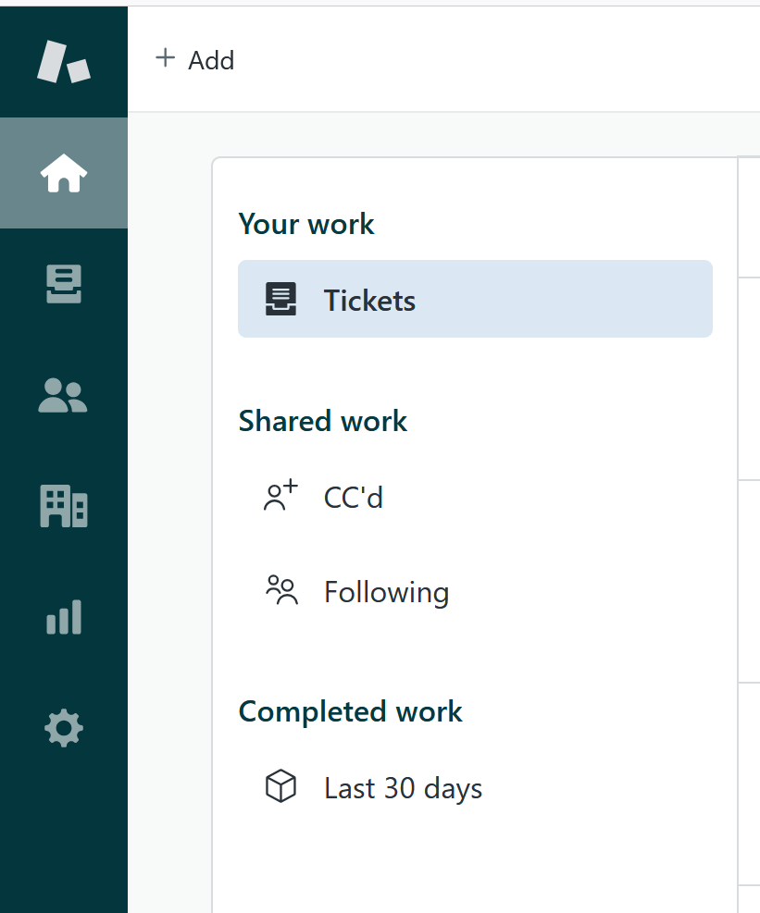
RI#1: Zendesk – Focal point for all support requests
Customer success: Monthly Support Report - July 2025
🛠️ RI#1 Zendesk – Establishing a Unified Entry Point for Support
As Owkin continues to scale, it's essential to align support infrastructure with organizational growth. In August , we plan to finalize the consolidation of all incoming support requests into Zendesk as the primary entry point, reducing fragmentation across Slack, email, and ad-hoc channels.
This effort aims to create a single source of truth for all support interactions, enabling faster response times, clearer ownership, and more consistent reporting.
✅ Key Improvements Implemented:
🔧 Ticket Visibility Enhancement
• Created a dedicated view for tickets tagged with k-signup-request
• Resolved visibility gaps for API-submitted onboarding tickets
🔧 Welcome Message Automation
• Implemented branded welcome messages for Abstra and Owkin K
• Personalized replies direct Owkin K users to the Help Center
• Messages are instant but do not impact FRT SLA, preserving reporting integrity
🌟 Why This Matters
These changes significantly improve first-touch user experience, reduce confusion, and foster a sense of proactive and structured support, especially as ticket volumes increase.
This foundation sets the stage for future expansion and ensures Zendesk can scale with Owkin's evolving support needs.

Slide 19
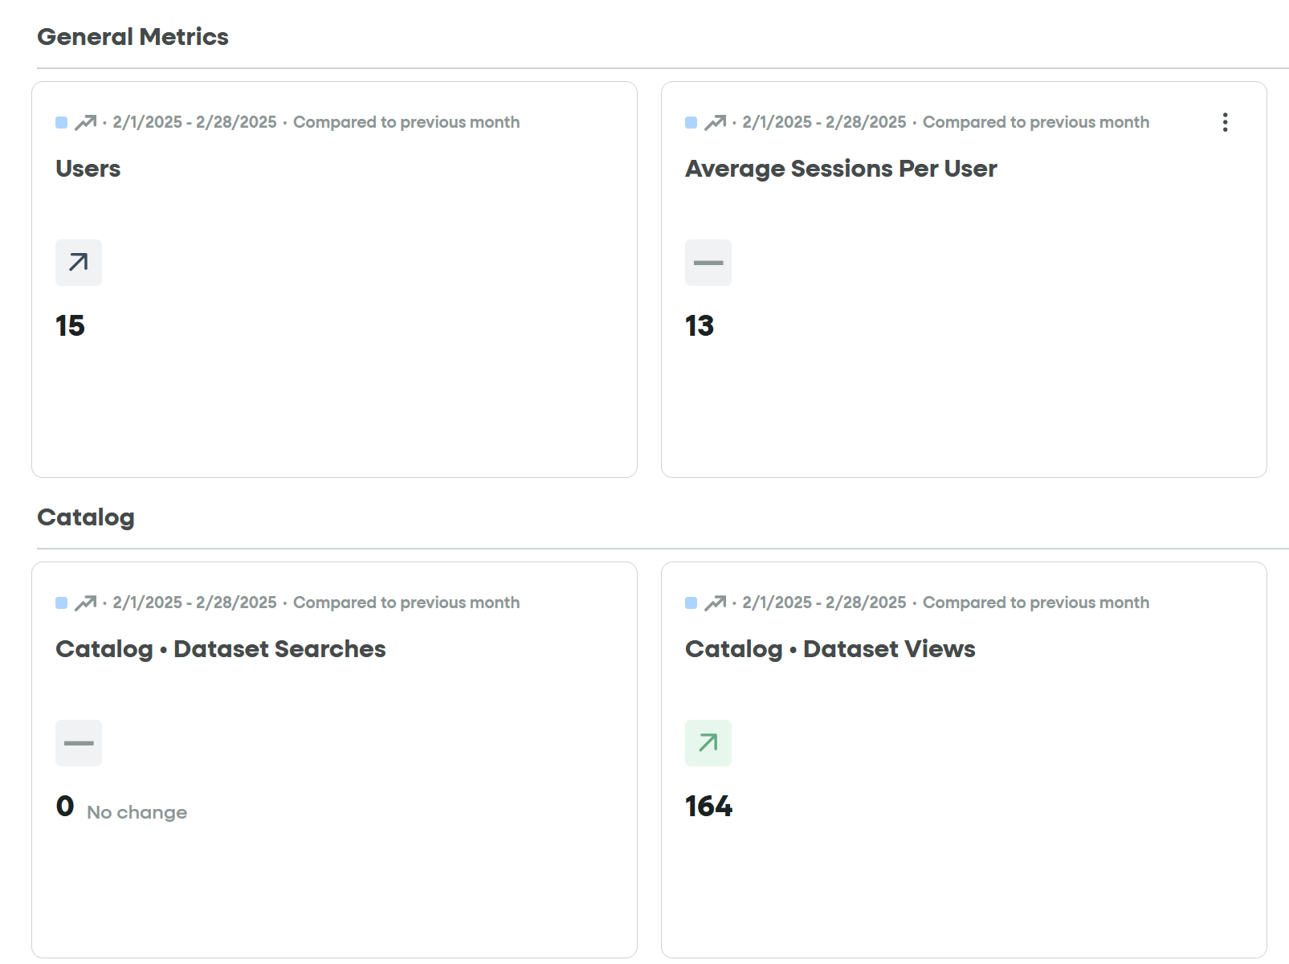
RI#2 PostHog Analytics Rollout for Support Operations
Customer success: Monthly Support Report - July 2025
🚀 RI#2 – PostHog Analytics Rollout for Support Operations
Objective
Implement a unified analytics system via PostHog to provide real-time visibility on triage efficiency, SLA adherence, and user interaction patterns across K-Navigator tickets.
Why it matters
Manual tracking of support metrics limits our ability to proactively detect SLA breaches and onboarding friction points. By migrating core KPIs into PostHog dashboards, we gain instant access to actionable data without relying on fragmented tools like FullStory and SurveySparrow.
→ PostHog dashboards will centralize key KPIs (First Response Time trends, Ticket Conversion Funnels, Rage Clicks).
→ Session analytics and targeted feedback widgets will enable smarter follow-ups post-resolution.
→ Automation of SLA breach alerts through dashboard views will support quicker escalations.
Expected Impact
→ Enhanced SLA tracking with live FRT and resolution time monitoring.
→ Consolidated reporting and analytics workflows, reducing tool switching.
→ Better identification of onboarding blockers through UX interaction data.
→ Improved team alignment via shared dashboard visibility (Product, Support, Engineering).

Slide 20
Agenda
1
Part I: Abstra support key metrics
2
Part II: Achievements & roadmap
3
Part III: Roadmap items
deep dive
4
Part IV: Product Insights
5
Part V: Next steps

Slide 21
Next steps for Customer Success
Customer success: Monthly Support Report - July 2025
Deliver excellent customer service
→ Maintain <30 min first response time for all requests with better triage priorities.
→ Resolve promptly signup access requests and streamline VPN clarifications for external Abstra users.
→ Continue direct Slack/Zendesk support for real-time troubleshooting and user onboarding assistance.
Strengthen Zendesk Operations
→ Track and report impact of the 3-strike auto-closure rule and updated ticket classification
→ Finalize and distribute Internal Support Playbook to standardize L1/L2 handling and triage flows.
→ Track impact of auto-closure logic and escalations, ensuring queue reduction and faster agent onboarding.
Please do not hesitate to reach out to me for any questions.
Operationalize Insights to Improve Onboarding Experience
→ Finalize PostHog dashboards for proactive SLA monitoring and UX friction tracking (replacing FullStory & SurveySparrow).
→ Use PostHog funnels and Rage Click metrics to detect workflow blockers in onboarding processes.
→ Collaborate with Product to align dashboard insights with UX adjustments and form logic improvements.
→ Implement targeted feedback collection post-resolution to continuously refine user onboarding experience.

Slide 22
Agenda
1
Part I: Abstra support key metrics
2
Part II: Achievements & roadmap
3
Part III: Roadmap items
deep dive
4
Part IV: Product Insights
5
Part V: Next steps

Slide 23
Thank you!

